Slide 1
Cookbook for Practice 7.1
实践7.1攻略
Cong Li 李聪

Slide 2
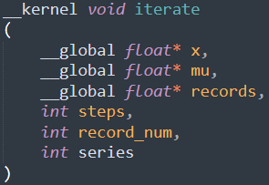
Write a GPU Kernel
写一个GPU Kernel (1)
Create a new file ‘kernel.c’
创建一个新文件’kernel.c’
Define a new function
定义一个新的函数
Input parameters
输入参数

Slide 3
Write a GPU Kernel
写一个GPU Kernel (1)
Create a new file ‘kernel.c’
创建一个新文件’kernel.c’
Define a new function
定义一个新的函数
Output records in 1D array for simplicity in GPU programming
用1维数组作输出记录，主要考虑GPU编程的便利

Slide 4


Write a GPU Kernel
写一个GPU Kernel (2)
Each thread processing a single series: get the thread ID
每个线程处理单个数列：获取线程ID
Hold ‘x’ & ‘mu’ in local variables
用局部变量掌控’x’和’mu’

Slide 5

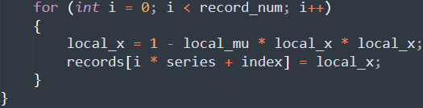
Write a GPU Kernel
写一个GPU Kernel (3)
Looping for compute (locally) for most iterations
对绝大多数轮次进行（局部）循环计算
Both compute & recording for the last several iterations
最后几轮既计算又存储

Slide 6


Basic Settings 基本设置 (1)
Create a new file ‘gpu.py’ & import relevant libraries
创建新文件’gpu.py’并导入相关库
Import ‘pyopencl’ library for OpenCL programs on GPUs
为在GPU上运行OpenCL程序导入’pyopencl’库
Configure number of series, iteration step,
number of records, & base number of coefficients
配置数列数量、迭代步数、记录大和基本系数个数

Slide 7
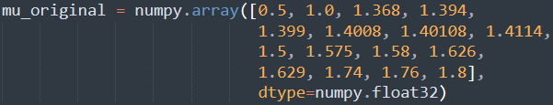

Basic Settings 基本设置 (2)
Configure coefficients
配置系数
Initialize host-side arrays for ‘x’, ‘mu’, & ‘records’
为’x’、’mu’和’records’初始化主机端的数组

Slide 8



OpenCL Runtime
OpenCL运行环境
Find the 1st OpenCL programming platform &
then the 1st device of the platform
找到第一个OpenCL编程平台，然后找到该平台中第一个设备
Create a queue for program execution on the device
为在该设备上运行程序创建一个队列
Read the file ‘kernel.c’ & compile the kernel
读取’kernel.c’文件并对kernel进行编译

Slide 9
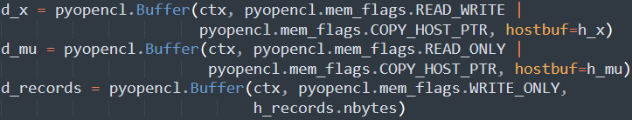
Host-to-Device Transfer
主机到设备的传输
Initialize device-side arrays &
copy ‘x’ & ‘mu’ from the host to the device
初始化设备端数组，并将’x’和’mu’从主机复制到设备

Slide 10

Kernel Execution Kernel的执行
Start timing 开始计时
Submit the kernel to the queue 向队列提交kernel
Queue to execute the kernel
执行该kernel的队列
Total thread number
总线程个数

Slide 11
Kernel Execution Kernel的执行
Start timing 开始计时
Submit the kernel to the queue 向队列提交kernel
Number of threads grouped
一组内的线程数

Slide 12
Kernel Execution Kernel的执行
Start timing 开始计时
Submit the kernel to the queue 向队列提交kernel
Input parameters
输入参数

Slide 13

Kernel Execution Kernel的执行
Start timing 开始计时
Submit the kernel to the queue 向队列提交kernel
Wait for completion of execution in the queue
等待队列执行完成
Stop timing & output the execution time
结束计时并显示执行时间

Slide 14
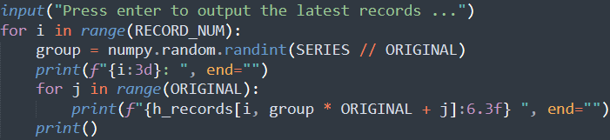
Output Results 输出结果
Copy the records back from the device to the host
将记录从设备复制回主机
Output selected records 输出选中的结果
Run it 运行之
python gpu.py

Slide 15
The End

